Slide 1
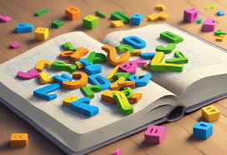
Puzzle Words Unscramble Game
TERM PROJECT BY:
RESHMA.KODAVALI
REGD.NO: 23BQ1A4281
PROJECT GUIDE :
Mr. M. PARDHA SARADHI,
Associate Professor

Slide 2
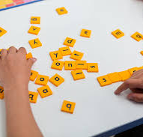
Introduction
Challenges players to rearrange mixed-up letters into meaningful words.
Enhances vocabulary, problem-solving skills, and quick thinking.
Suitable for all ages, with varying difficulty levels.
Can be played solo or with friends, promoting cognitive development and teamwork.
Popular for both education and entertainment.
Strikes a perfect balance of challenge and fun.

Slide 3
Existing system and Proposed system
Existing System
Proposed System
Simple Gameplay: Players unscramble 5-letter words within a 60-second limit, using hints to guide
guesses.
Basic Scoring: A straightforward scoring system rewards one point per correct answer without bonuses or penalties.
Minimal Interface: Features a color-coded display for words, scores, hints, and a countdown timer.
Visual Design: Basic color-coded feedback is used to distinguish between elements like hints, score, and timer.
Enhanced Gameplay Mechanics: Adds difficulty levels, streak bonuses, and varying word lengths for more dynamic challenges.
Advanced Features: Introduces multiplayer mode, themed challenges, and a leaderboard for competitive engagement.
Improved Visuals and Feedback: Incorporates animations, thematic color schemes, and upgraded hint systems for better player immersion.
Upgraded Hints: Offers advanced hints like revealing more letters or word categories at a score cost.

Slide 4
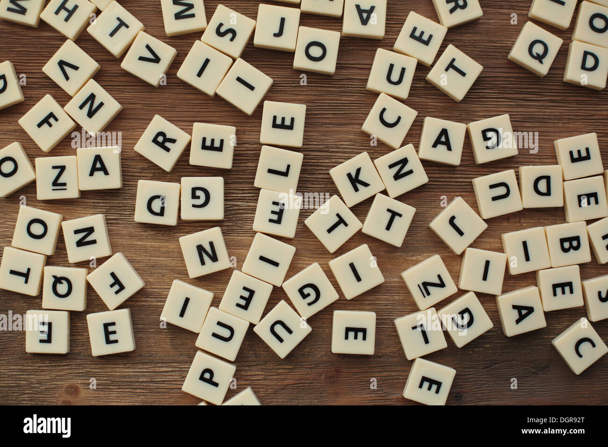
CONCEPT
Game Concept: Unscramble a 5-letter word within a time limit.
Gameplay: Scrambled Word: 5-letter word scrambled (e.g., "epalp" for "apple").
Hint: First and last letters provided.
Timer: 60 seconds per round.
Scoring: 1 point for each correct guess. If time runs out or guess is wrong, the correct word is shown.
Continuation: New words appear after each round for endless play and score improvement.

Slide 5
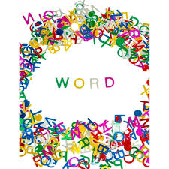
Features: Simple interface, guess with "Enter." Timer for urgency, hints with first and last letters. Colorful design for key elements. Instant feedback on guesses.
Objective: Unscramble and guess as many words as possible within the time limit.
Audience: Casual game for all ages to improve word recall and problem-solving.
Game Flow: Start Screen: Intro before gameplay. Gameplay: Guess scrambled word in 60 seconds. Feedback: Correct or incorrect feedback. Next Round: New word after each round. Exit: Game ends when closed.

Slide 6
DESIGN Architecture Overview: The architecture of the Puzzle Words Unscramble game is modular, ensuring ease of development, maintenance, and scalability. It is divided into four major components: User Interface (UI): Displays scrambled word and challenge. Handles user input (guessing, submitting, backspace). Provides real-time feedback (correct/incorrect). Shows timer, score, and hints (first and last letters). Game Logic: Manages word scrambling, guessing, and validation. Data Management: Handles word lists, user data, and game state storage. Timer and Scoring System: Manages countdown timer and player scoring. Each component works together to create a seamless gaming experience.

Slide 7
Game Logic: Scrambles words and compares player guesses. Manages game flow, transitioning between rounds. Controls countdown timer and resets after each round. Data Management: Manages word list, ensuring valid words are selected. Filters words based on length (e.g., five-letter words). Uses NLTK for random word selection, ensuring variety. Timer and Scoring System: Tracks time (60 seconds per round) and resets after each round. Updates and displays player score based on correct guesses. Adjusts difficulty by modifying time or rounds.

Slide 8
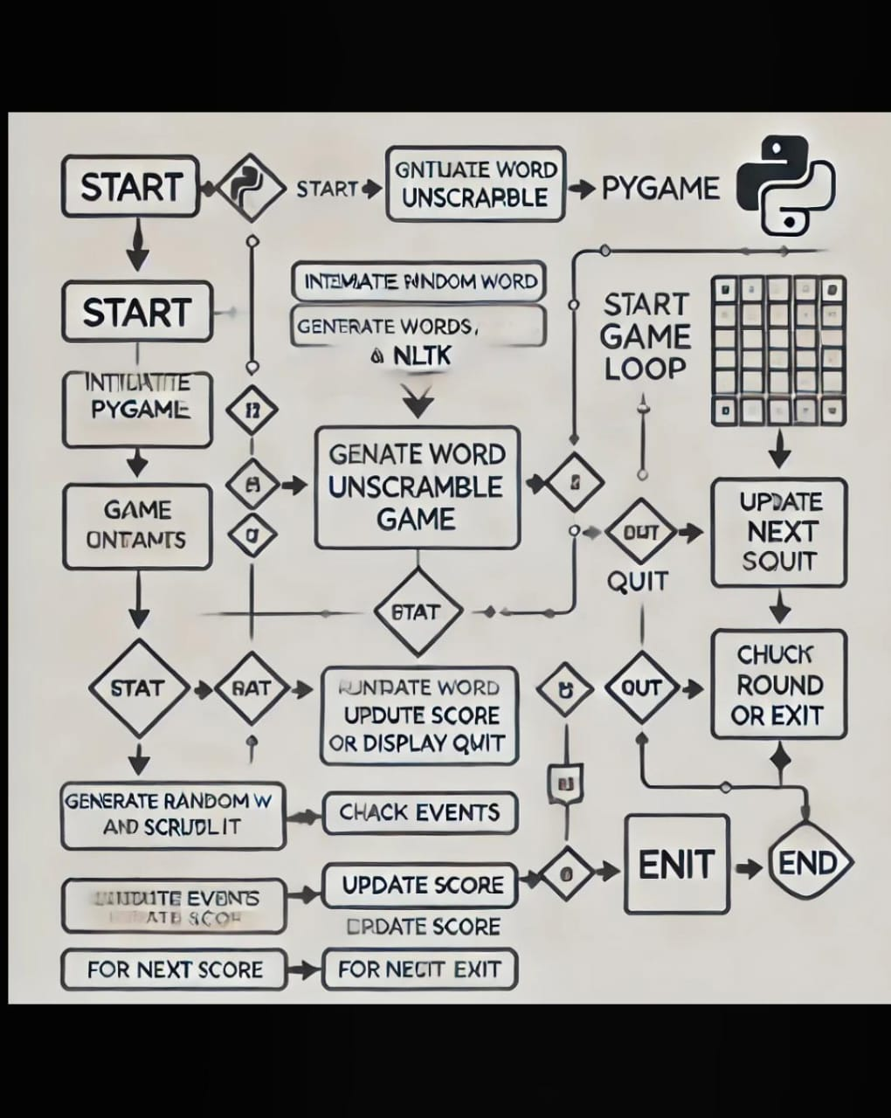

FLOW CHART

Slide 9
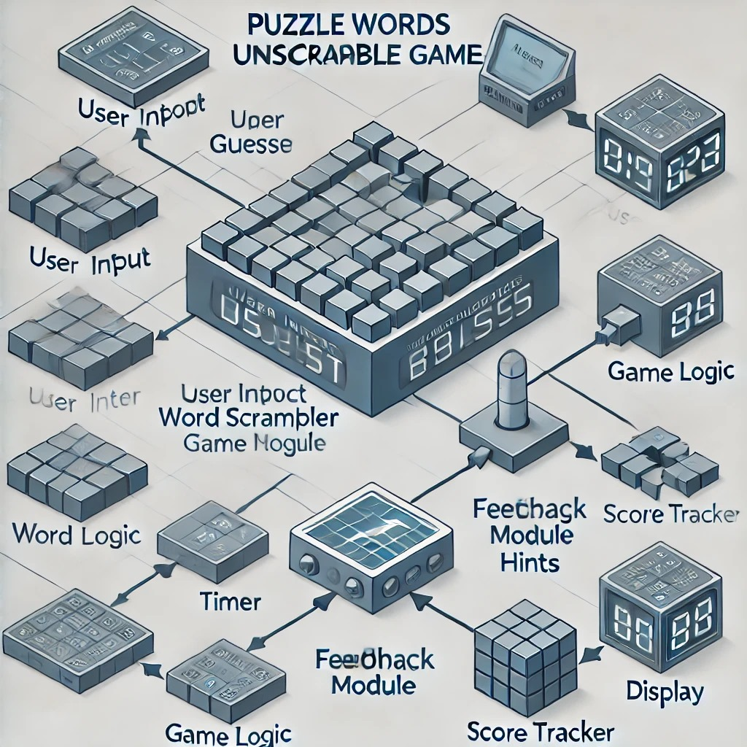

Slide 10
Block Diagram
User Input: Player types their guess.
Word Scrambler: Scrambles the original word.
Game Module: Handles core gameplay logic (guess checking, interactions).
Word Logic: Validates the guess against the original word.
Timer: Tracks remaining time.
Feedback Module: Provides feedback (correct/incorrect, hints).
Score Tracker: Updates score on correct guesses.
Display: Renders visual elements (word, timer, score).
Game Logic (Central Module): Manages interactions between all components.
Flow of Interaction:
Player inputs guess → Word Scrambler generates puzzle → Game Logic checks guess → Feedback Module responds → Score Tracker updates → Timer resets → Display updates.

Slide 11
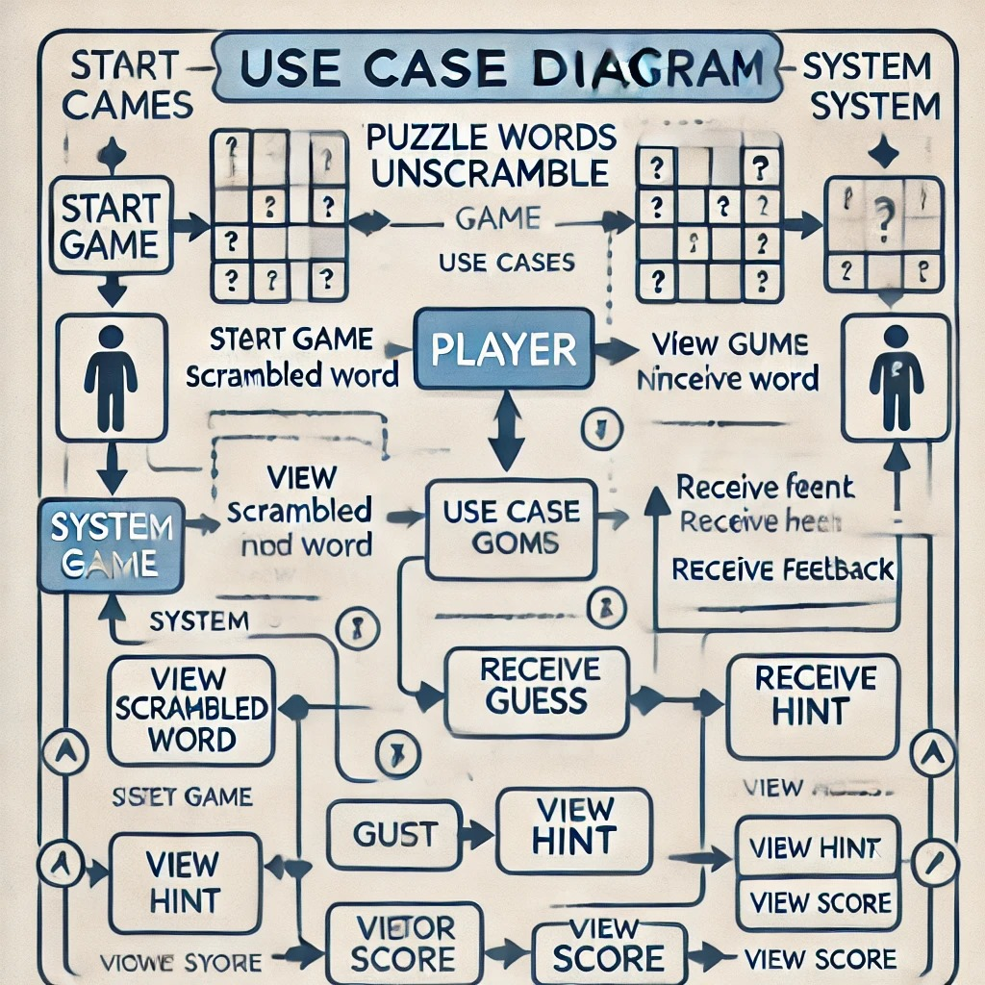
USE CASE DIAGRAM

Slide 12
USE CASE DIAGRAM
Use Case Diagram - Word Unscramble Game
Actors:
Player: User interacting with the game.
System: Manages game logic and feedback.
Main Use Cases:
Start Game: Player starts; system shows scrambled word.
View Hint: Player requests a hint.
Submit Guess: Player guesses the word.
Receive Feedback: System checks guess and provides feedback.
View Score: Player views score.
Flow:
Player starts → System shows scrambled word → Player guesses or requests hint → System provides feedback and updates score.
Design Goal:
Smooth gameplay with clear feedback and score tracking.
.

Slide 13
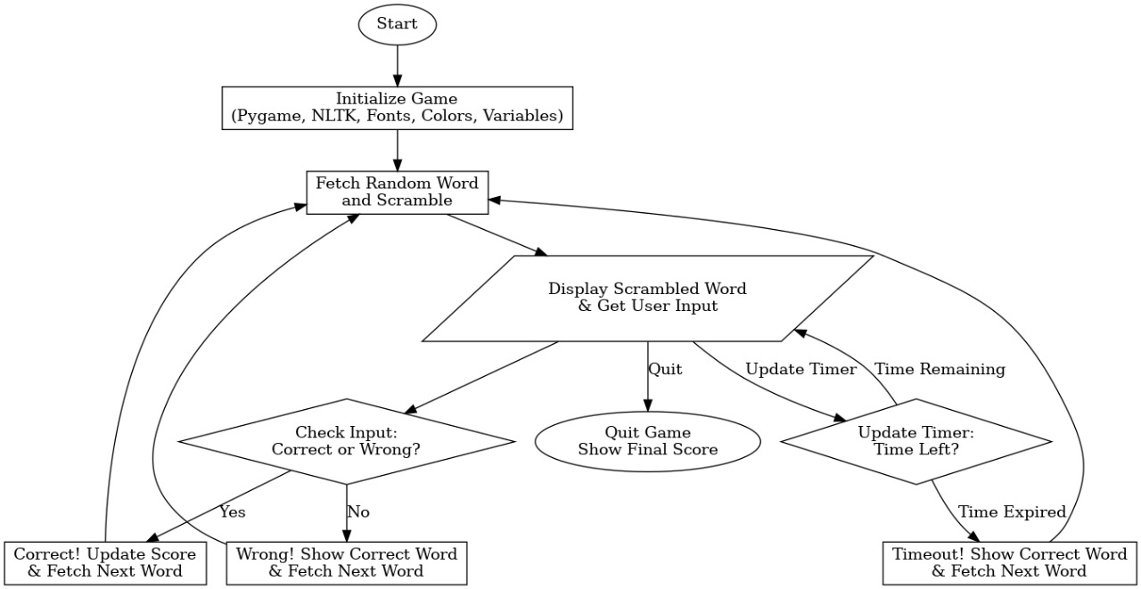
DFD DIAGRAM

Slide 14
IMPLEMENTATION MODULE-WISE IMPLEMENTATION
Pygame Module
Purpose: Handles graphics, events, and gameplay.
Key Functions:
pygame.init(), pygame.display.set_mode(), pygame.display.set_caption(): Setup display.
pygame.font.Font: Loads fonts.
pygame.event.get(), pygame.key: Detects user input.
pygame.time.Clock(): Controls frame rate.
Game Loop: Manages updates and rendering.
NLTK Module
Purpose: Supplies word list.
Key Usage:
nltk.download('words'): Downloads word corpus.
words.words(): Retrieves word list.
Filtering: Selects 5-letter words.

Slide 15
Game Settings and Initialization
Screen Setup:
WIDTH, HEIGHT: Defines game window resolution.
screen = pygame.display.set_mode(): Configures window.
Fonts and Colors: Defines colors and fonts for text rendering.
Game Variables:
TIME_LIMIT: Sets round duration (60 seconds).
player score: Tracks player score.
Utility Functions
Purpose: Modular functions for reusability.
scramble_word(word): Scrambles word and ensures it’s different from the original.
get_random_word(): Selects random word from pool.
get_hint(word): Provides first and last letters as hint.
Game Features
Real-Time Countdown Timer: Adds time challenge.
Dynamic Feedback: Updates message based on guess correctness.
Hints: Displays first and last letters for help.
Score Tracking: Updates and shows player score after each round.

Slide 16
Main Game Loop (game_loop)
Purpose: Manages core gameplay.
Key Features:
Game Variables: Tracks current_word, scrambled_word, user_input, message, hint_message, and timer.
Rendering: Renders text (word, score, input, messages) using pygame.font.Font.render.
Timer: Countdown resets when time runs out.
Event Handling: Detects actions (typing, submitting, deleting, quitting).
Turn Progression: Checks guess, updates score, generates new word, resets variables.

Slide 17
PUZZLE WORDS UNSCRAMBLE GAME CODE
def. scrambled_word(word):
scrambled = ''.join(random.sample(word, len(word)))
return scrambled if scrambled != word else scramble_word(word)
def get_random_word():
return random.choice(word_list)
def get_hint(word):
return f"Hint: Starts with '{word[0]}' and ends with '{word[-1]}'"
timer -= 1 / 30
if timer <= 0:
message = f"Time's up! The correct word was '{current_word}'."
timer = TIME_LIMIT
current_word = get_random_word()
scrambled_word = scramble_word(current_word)
user_input = ""
hint_message = get_hint(current_word)

Slide 18
word_text = FONT.render(f"Scrambled: {scrambled_word}", True, RED)
score_text = FONT.render(f"Player Score: {player_score}", True, BLUE)
input_text = FONT.render(f"Your Guess: {user_input}", True, ORANGE)
message_text = FONT.render(message, True, GREEN)
hint_text = FONT.render(hint_message, True, PURPLE)
timer_text = FONT.render(f"Time left: {int(timer)}s", True, GOLD)
if event.key == pygame.K_RETURN:
if user_input.lower() == current_word:
message = "Correct! You guessed it."
player_score += 1
else:
message = f"Wrong! The correct word was {current_word}."
current_word = get_random_word()
scrambled_word = scramble_word(current_word)
user_input = ""
hint_message = get_hint(current_word)
timer = TIME_LIMIT
elif event.key == pygame.K_BACKSPACE:
user_input = user_input[:-1]
else:
user_input += event.unicode
pygame.quit()

Slide 19
PACKAGES AND TOOLS USED
Packages and Tools:
Pygame: For game development.
pygame.init(), pygame.display.set_mode(), pygame.display.set_caption()
pygame.font.Font(), pygame.time.Clock()
pygame.event.get(), pygame.KEYDOWN, pygame.K_RETURN, pygame.K_BACKSPACE
Random:
random.sample(), random.choice()
NLTK:
nltk.download('words'), nltk.corpus.words.words()
Tools:
Rendering: pygame.font.Font(), screen.fill(), screen.blit()
Timer: Countdown displayed in real-time.
Event Handling: Handles key events (Enter, Backspace)

Slide 20
TESTING
. Test Cases & Expected Outputs
Word Scrambling
Input: "hello"
Expected Output: Scrambled word (e.g., "oellh", "lehlo").
Hint Generation
Input: "apple"
Expected Output: "Hint: Starts with 'a' and ends with 'e'".
Correct Guess
Input: "hello" (guess: "hello")
Expected Output: "Correct! Score +1".
Incorrect Guess
Input: "hello" (guess: "world")
Expected Output: "Wrong! Correct word: hello".
Timer Countdown
Input: Timer starts at 60 seconds
Expected Output: Timer counts down and resets after each round.

Slide 21

Expected Outputs
Timer Countdown
Input: Timer starts at 60s.
Output: Decreases by 1 second per 30 frames. "Time's up!" after 60s.
Backspace Functionality
Input: "hell" (backspace).
Output: Text updates to "hel."
Game Reset After Time's Up
Input: Timer runs out.
Output: New word, input reset, timer restarts at 60s.
Sample Input & Output
Input:
Scrambled: "pale"
Guess: "leap"
Hint: "Starts with 'l' and ends with 'p'"
Output:
Correct: "Correct! Score: 1"
Incorrect: "Wrong! Correct word: 'pale'. Score unchanged."
Timer: "Time left: 59s."

Slide 22
Testing Screenshots
Game Start: Show initial screen with scrambled word, hint, and timer.
Correct Guess: Show updated score after a correct guess.
Incorrect Guess: Show correct word and message after an incorrect guess.
Game Over / Time's Up: Display message with correct word when timer runs out.
Performance Testing
Ensure consistent 30 FPS and no lag during transitions. Use pygame.time.get_ticks() to measure frame time.
Edge Cases
Handle empty word list (ensure only 5-letter words).
Handle empty user input and pressing enter.
Proper reset of word, input, and timer when time hits zero.

Slide 23
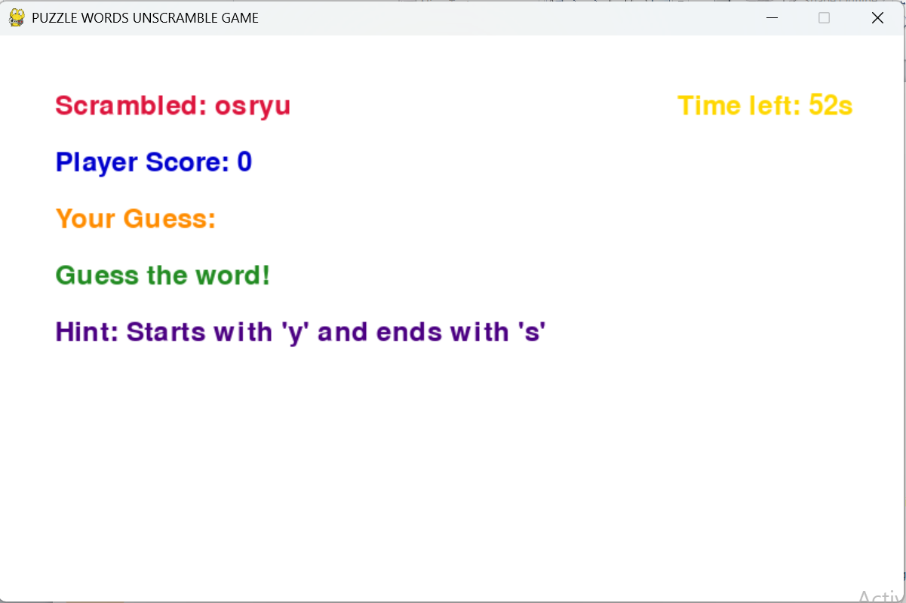

Slide 24
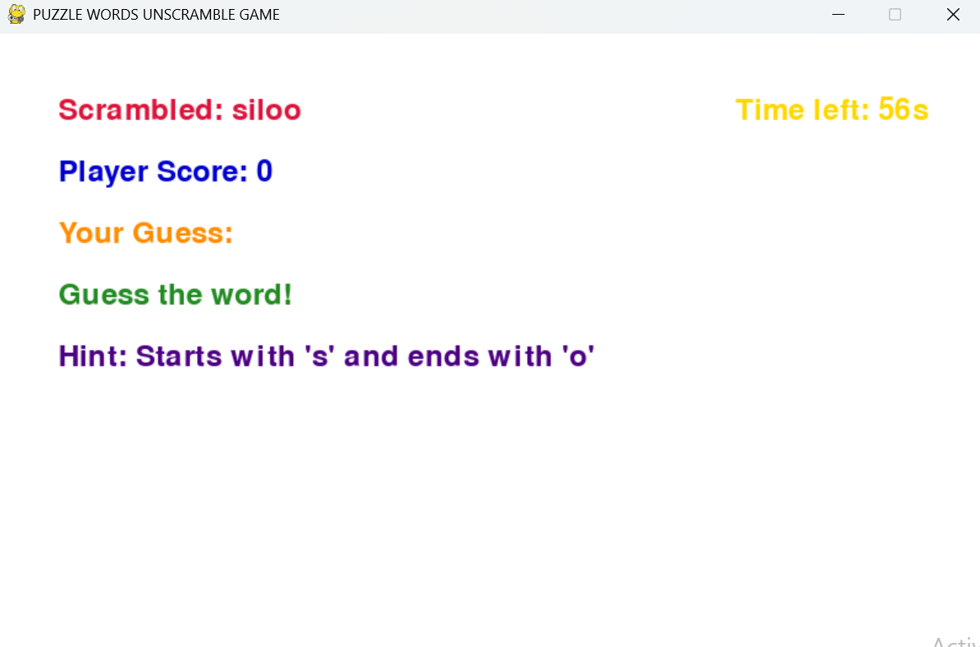


Slide 25
CONCLUSION
The Puzzle Words Unscramble Game provides a fun and educational experience with features like word scrambling, a hint system, a countdown timer, and scoring. Players unscramble words within a time limit, with hints offering support while keeping the challenge. The scoring system motivates improvement, and the user-friendly interface ensures smooth gameplay. Overall, it effectively enhances vocabulary skills in an enjoyable way.

Slide 26
Future Scope for the Word Unscramble Game
Multiplayer Mode: Turn-based or cooperative gameplay.
Difficulty Levels: Easy, medium, and hard modes.
Word Categories: Choose themes like animals or food.
Enhanced Hints: Definitions, synonyms, or partial reveals.
Player Challenges: Scramble words for the computer.
Power-Ups: Add time or reveal letters; penalties for wrong guesses.
Leaderboards: Track scores and achievements.
Sound & Music: Add effects and background tracks.
Mobile Version: Broaden access to mobile platforms.
Accessibility: Text-to-speech and customizable features.
Adaptive AI: Adjusts difficulty dynamically.
Educational Features: Teach word meanings and synonyms.
Bonus Modes: Speed rounds or reverse unscrambling.

Slide 27
References
Pygame: Used for creating the graphical user interface (GUI), managing screen rendering, handling fonts, processing user events like key presses, and running the main game loop to keep the game interactive.
NLTK: Utilized to access an English word corpus (words.words()), ensuring a diverse and valid word list for generating puzzles.
Python Random Module: Employs random.sample() to shuffle characters and scramble words dynamically for each round, maintaining game variety.

Slide 28
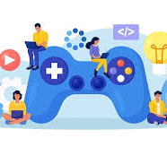

Thank you

